Slide 1


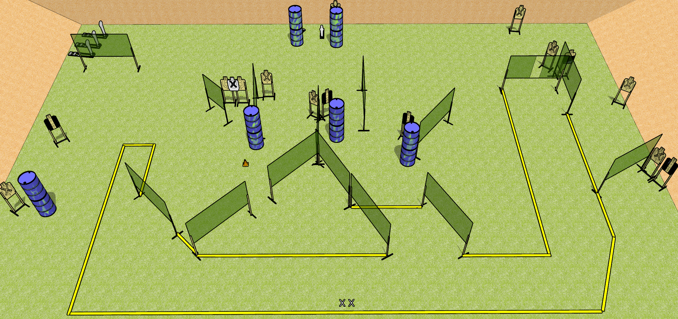
 | Dothan Gun Club – USPSA Match Bring Your A-Game Course Designer : Drew Coleman
Round Count 35 rounds 15 USPSA targets 3 colt poppers, 2 USPSA mini poppers
Equipment List 26 wall feet Setup Note: there’s a mini behind the left set of barrels by the berm, and a paper target behind the other set to the right.

Slide 2
Bring Your A-Game
Written Stage Briefing
Bring Your A-Game is a 35 round, 175 point, Comstock field course. There are 15 USPSA targets, 3 colt poppers, and 2 USPSA mini poppers. The best two hits on paper will score, and steel must fall to score.
Handgun start position is both feet on X’s, wrists below belt. Handgun is loaded and holstered.
PCC start position is both feet on X’s. Loaded carbine is held with both hands, stock on belt, safety on.
On start signal, engage targets as they become available from within the shooting area.

